Slide 1
Your AI Assistant (yaia.ai) Our Future is Written in Code
2nd August 2023

Slide 2
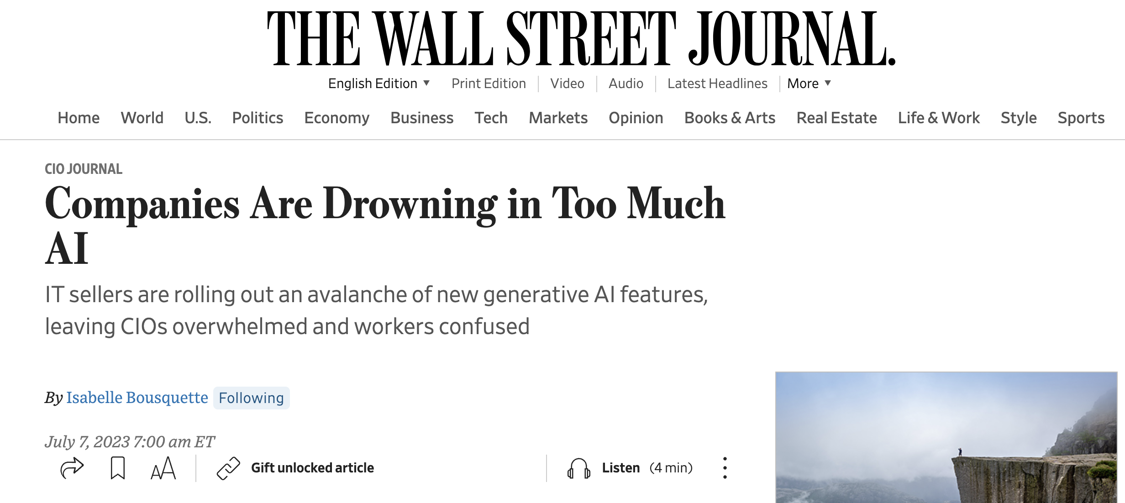
Today the Enterprises are drowning in AI related information
Almost everyday a new Language Model is coming out
While there are plenty of ChatBots around, most of them do not scale to Enterprise needs
No easy and fast way to adopt Generative AI in the Enterprise
Disconnected, disjointed and fragmented solutions will lead to redundancy and increased cost of adoption

Slide 3
So you need an AI Assistant who will help you adapt fast, meet your Generative AI requirements in a cost effective manner and it will be easy to use by all your employees without lot of training.
Answer Questions
Encourage Creativity
Automate Workflows
Notes:
So you need an AI Assistant that will help you adapt fast, meet your Generative AI requirements in a cost effective manner and will be easy for all your employees to use without a lot of training

Slide 4
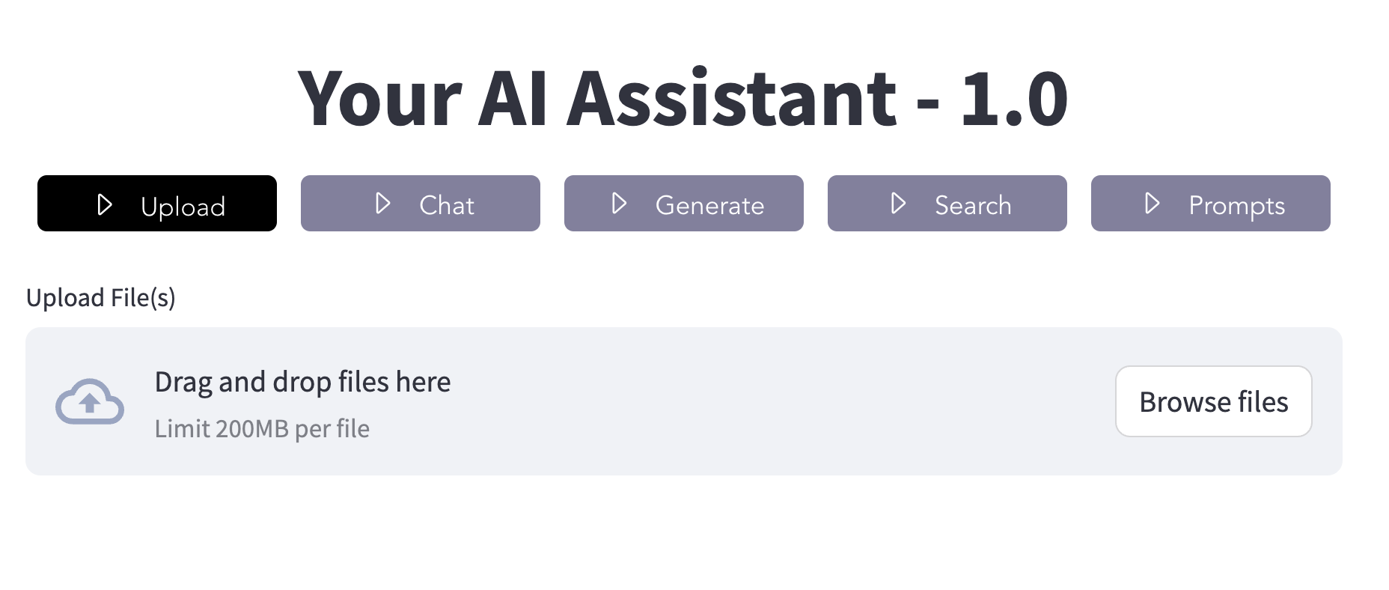
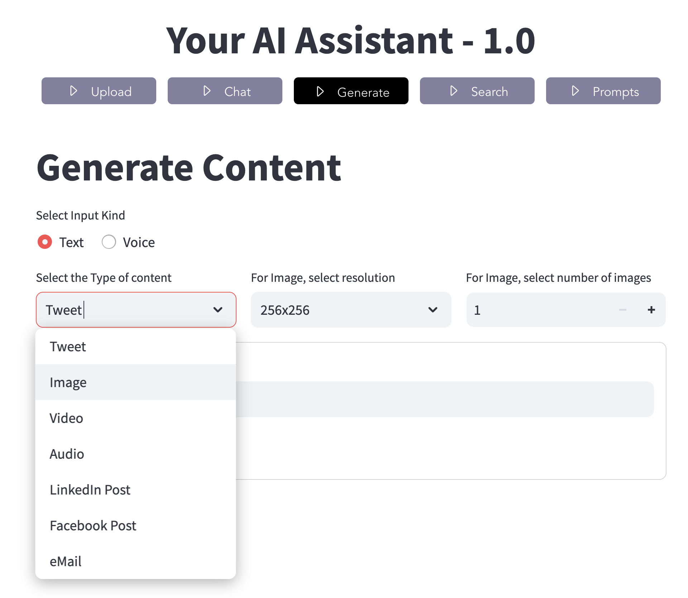
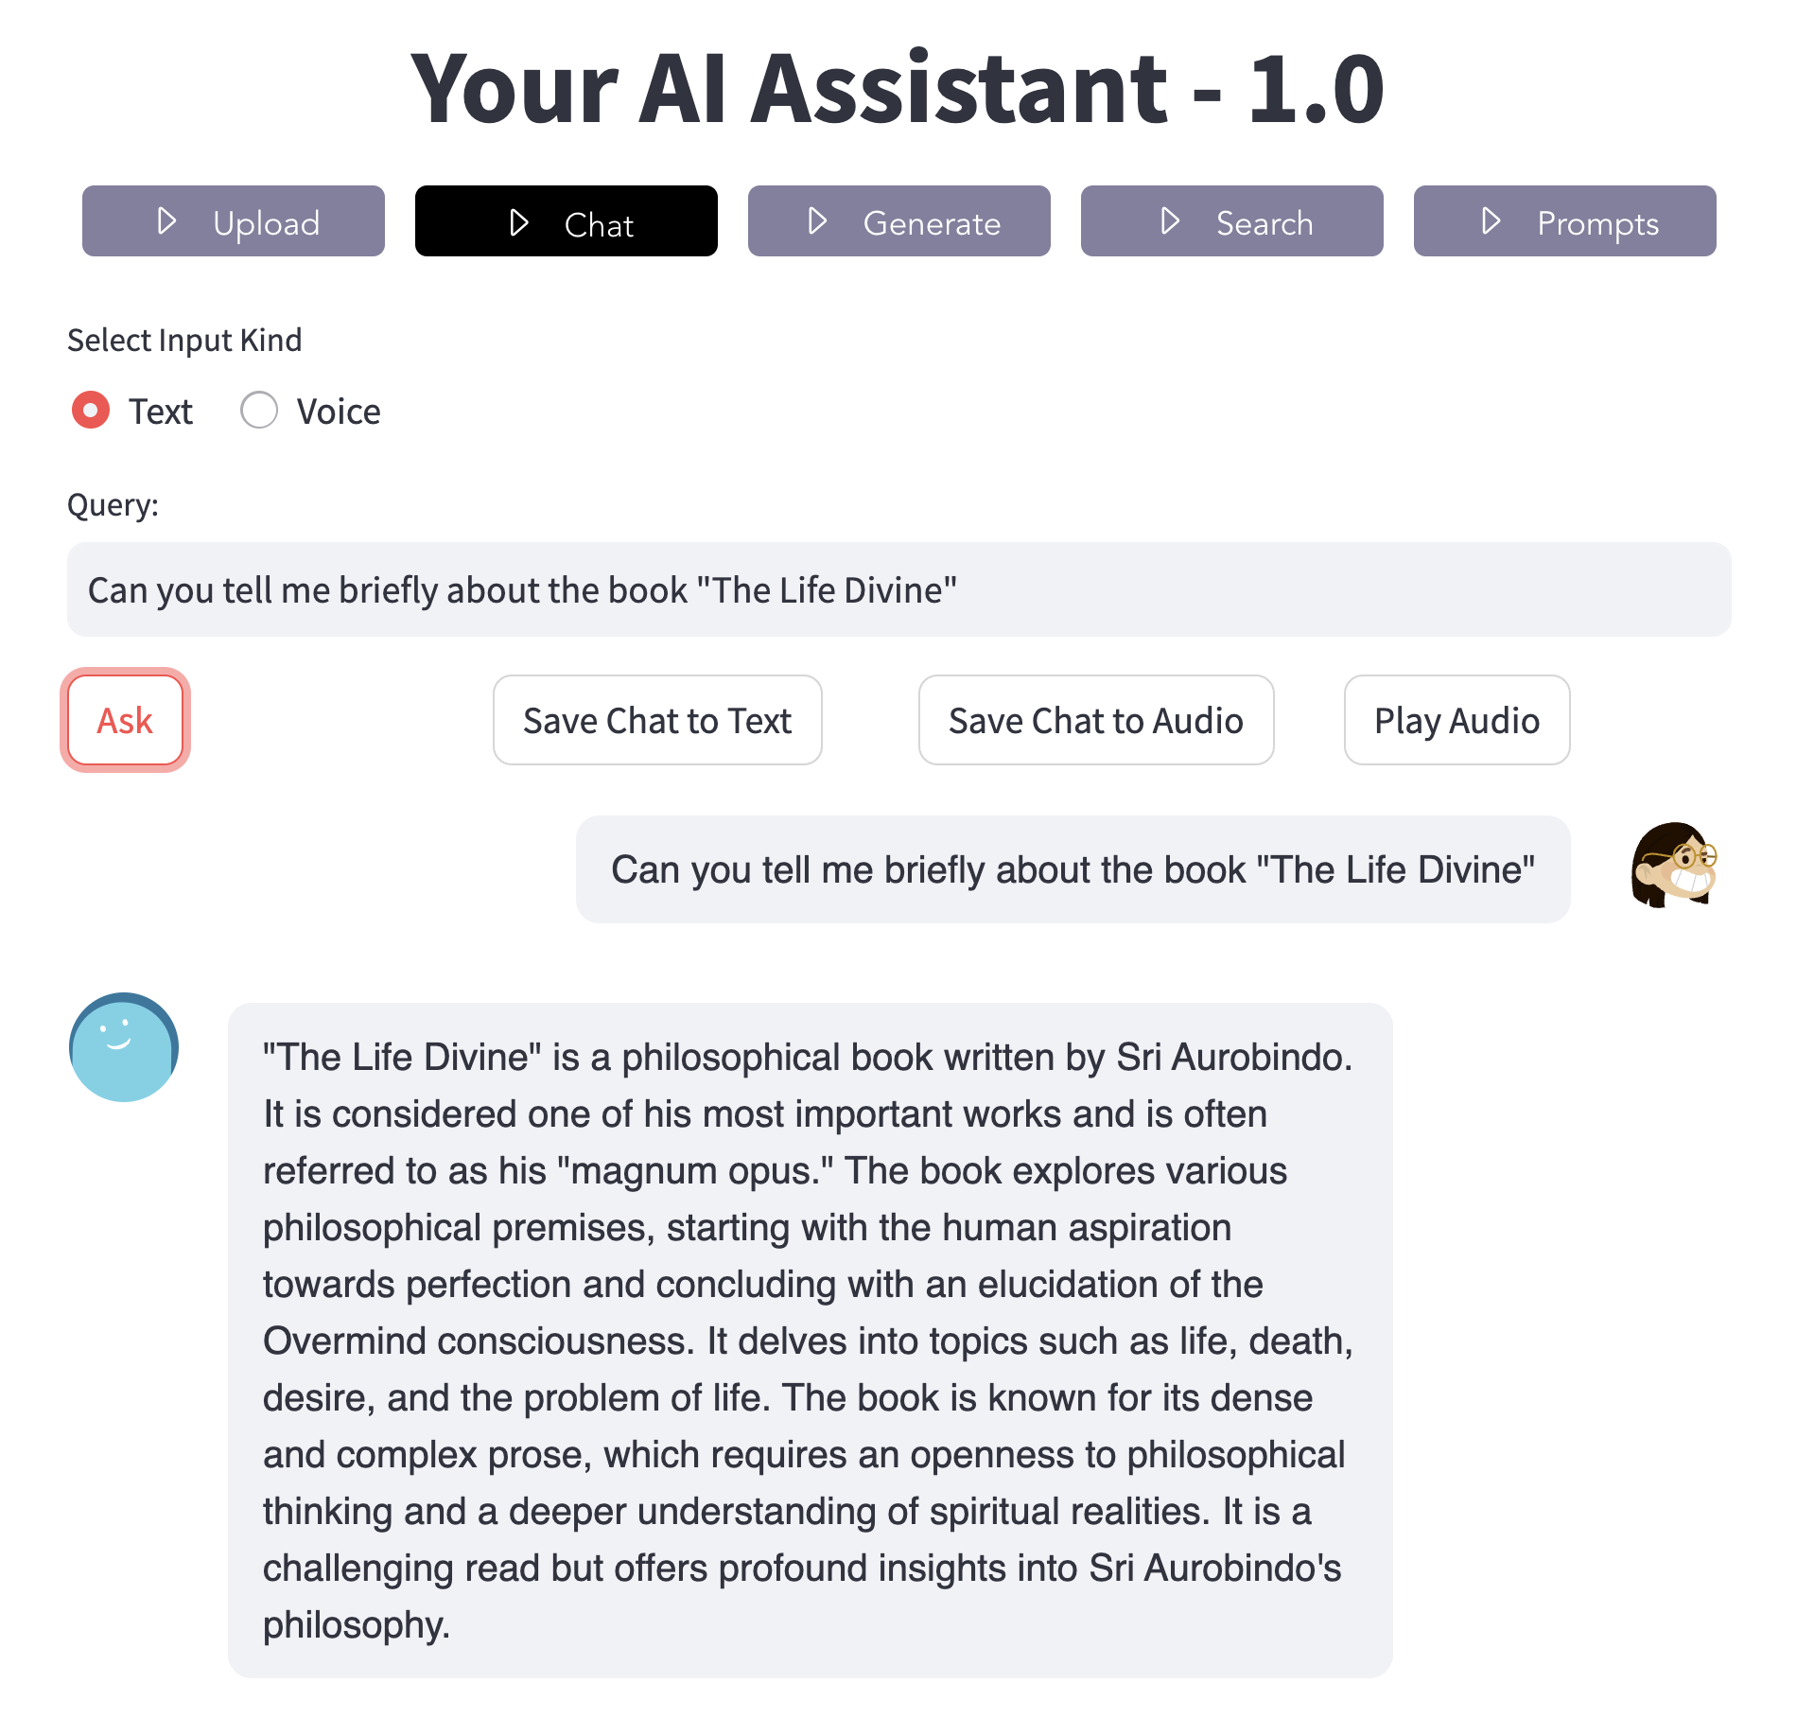
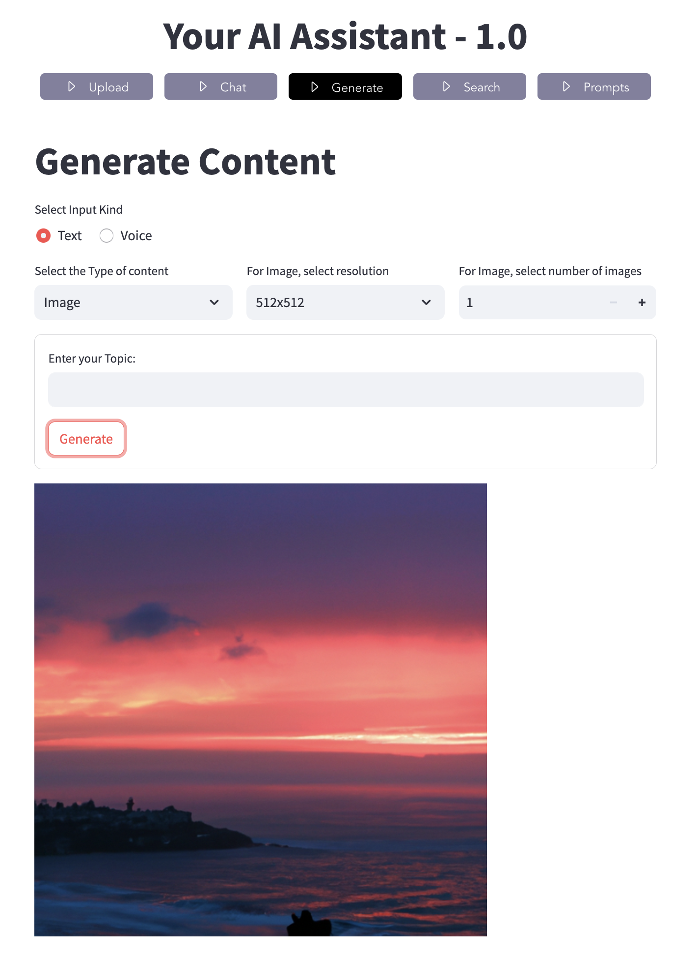

Slide 5
What will YAIA do for you?
Help you adopt Generative AI fast
Provide a Platform that you can use for any specific Industry like Retail and domain like Sales, thus supporting an extensive no of Use Cases
Multimodal – supports Text, Image, Audio and Video
You can plug in any Generative AI model– no dependency on any vendor lock in
Easy to use with minimal learning curve and training
It will significantly improve Productivity of your people
Notes:
Extensive number of use cases significantly improve the productivity of your people

Slide 6
Demo and Q&A

